Slide 1

Database Systems
CS 372
LAB 1

Slide 2

Lab policy..
Attendance is mandatory
Each student will be evaluated at the end of the lab.
The student must demonstrate a clear understanding by answering questions from the MS before she leaves the lab.
Keep the clean of lab .
Feel free to interrupt and ask!
Being at the lab on-time and making sure you understand the topic are very important.
!

Slide 3


BEFORE WE START
Your Cell Phone Silent
Please Keep Quite

Slide 4
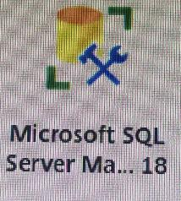
Objectives
What is the DataBase?
What is the DataBase Management System (DBMS).
Overview of SQL
How to use Citrix applications
Getting started with Microsoft SQL Server 2018

Slide 5
What is the Database
A database is collection of related data that it can easily be accessed, managed, and updated.

Slide 6
What is Data Base Management System (DBMS)
A Database Management System (DBMS) is a set of computer programs that controls the creation, maintenance, and the use of the database in a computer platform .
EX: MS Access , Oracle ,MySQL.

Slide 7
Data Base Management System (DBMS)
The most typical DBMS is a relational database management system (RDBMS).
RDBMS data is structured in database tables, fields and records.
So, each RDBMS table consists of database table rows.
Each database table row consists of one or more database table fields.

Slide 8
Data Base Management System (DBMS) (cont.)
DB
Table
Field - column
Tables
Record – Entry - row

Slide 9
SQL: Structured Query Language
SQL is a very powerful language used to create and query databases.
SQL is the standard language for Relation Database System and the most RDBMS uses.
SQL allows you to :
access data in relational database management systems.
create and drop databases and tables.
create view, stored procedure, functions in a database.
set permissions on tables, procedures, and views

Slide 10
SQL Statements
1. Data definition language (DDL) | CREATE ALTER DROP RENAME TRUNCATE
2. Data manipulation language (DML) | INSERT UPDATE DELETE MERGE
3. Data control language (DCL) | GRANT REVOKE

Slide 11
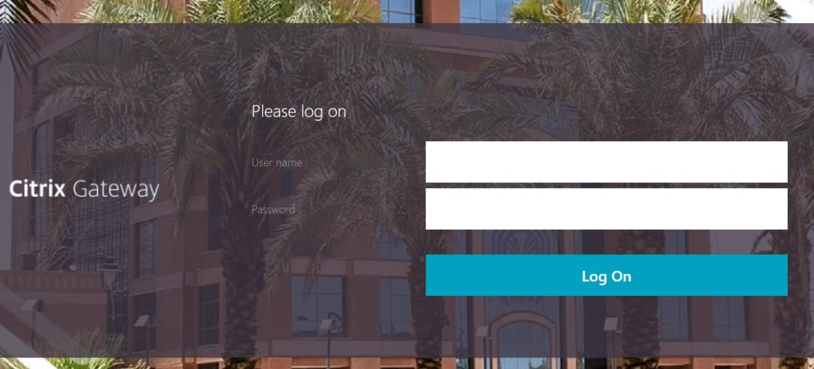
How to use Citrix Applications
1
Copy the following link to your browser
Tuvlab.taibahu.edu.sa

Slide 12
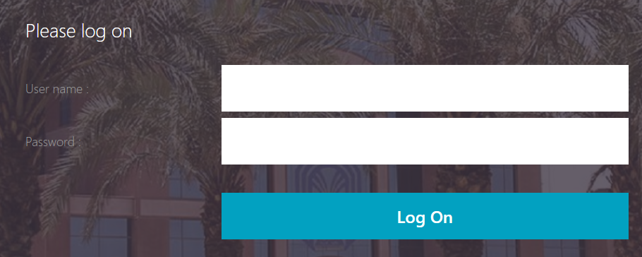
How to use Citrix Applications
2
University ID
Identification Number
Or
Email password

Slide 13
How to use Citrix Applications
2
University ID
Identification Number
Or
Email password

Slide 14

How to use Citrix Applications
3

Slide 15
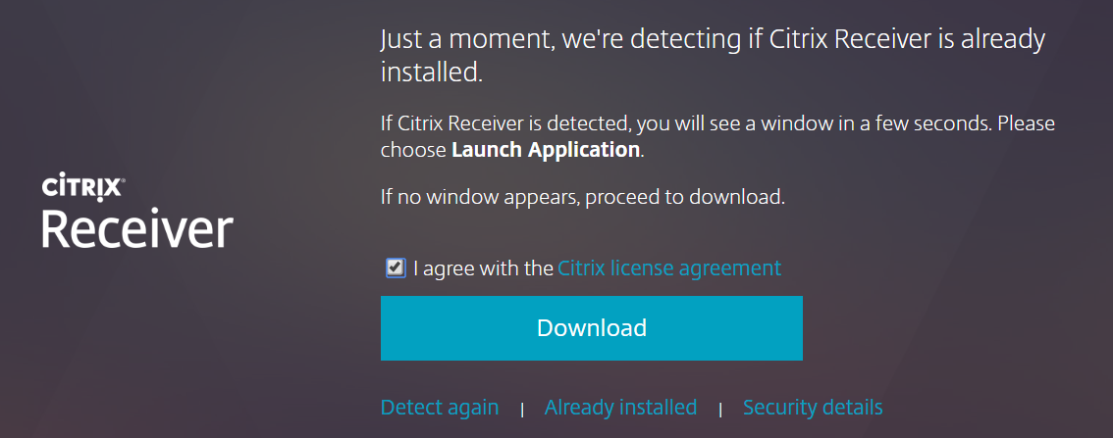
How to use Citrix Applications
4

Slide 16
How to use Citrix Applications
4

Slide 17

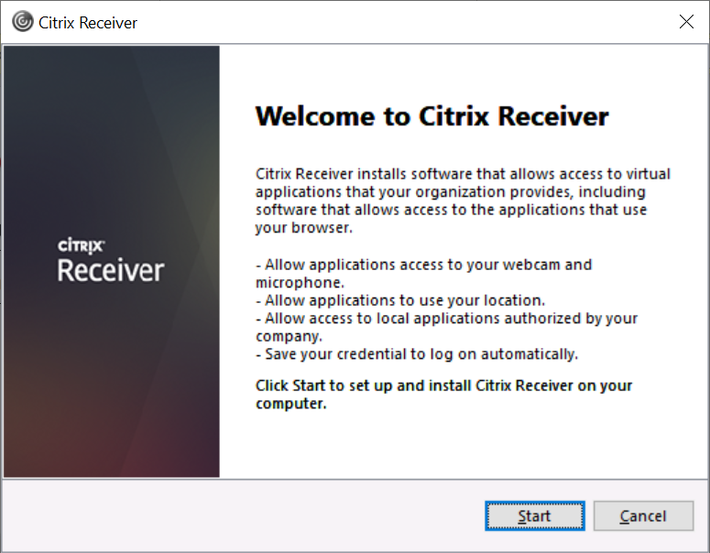
How to use Citrix Applications
After downloading the Citrix file
5
Double clicking

Slide 18
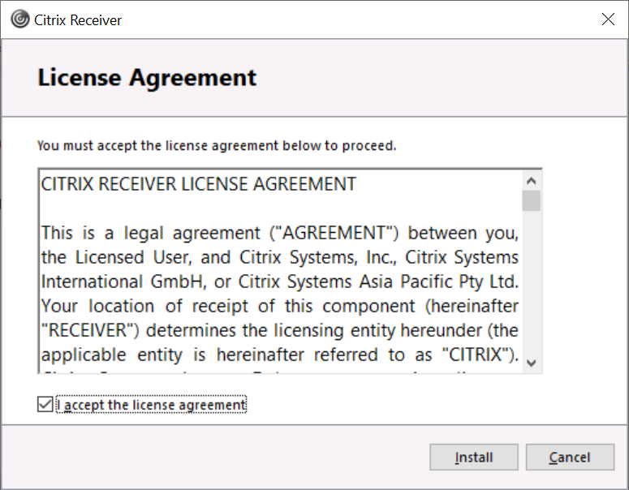
How to use Citrix Applications
After downloading the Citrix file
6

Slide 19
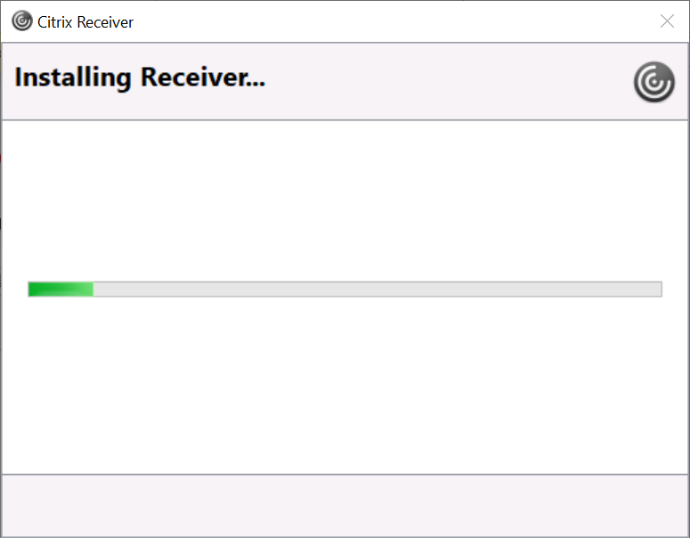
How to use Citrix Applications
After downloading the Citrix file
7

Slide 20
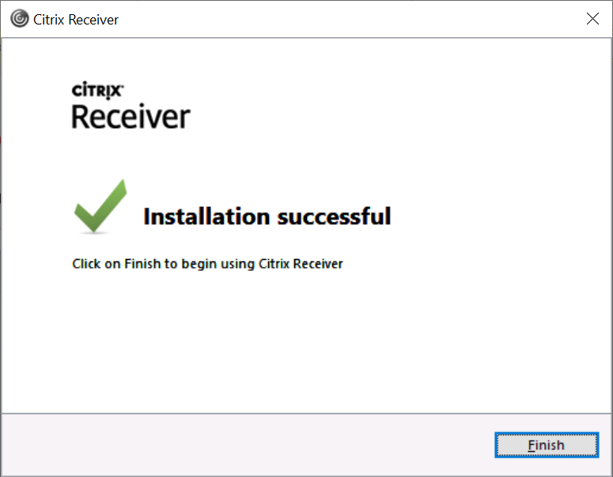
How to use Citrix Applications
After downloading the Citrix file
8

Slide 21

How to use Citrix Applications
Go back to the site
9

Slide 22
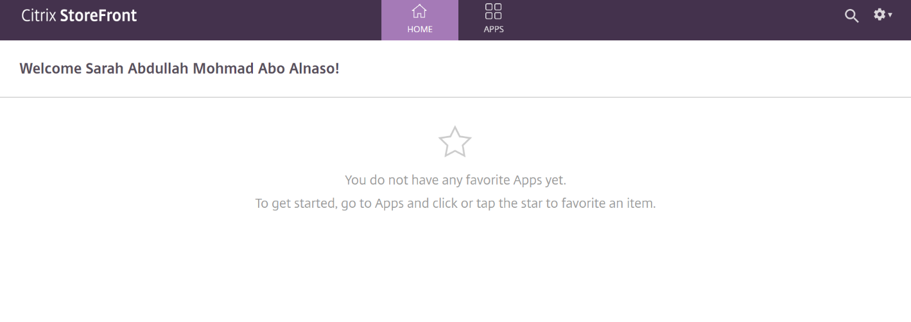
How to use Citrix Applications
10
Click here

Slide 23
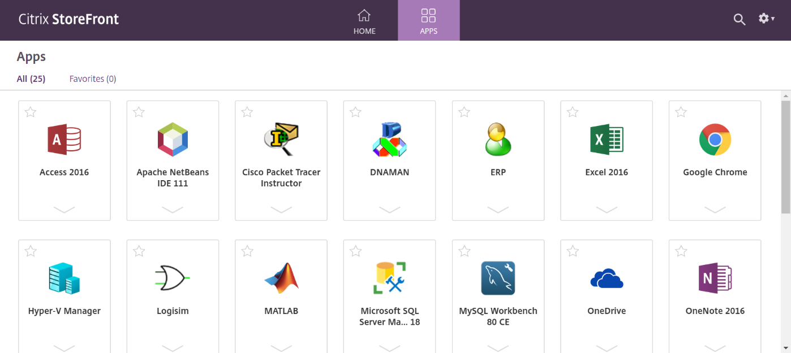
How to use Citrix Applications
11

Slide 24
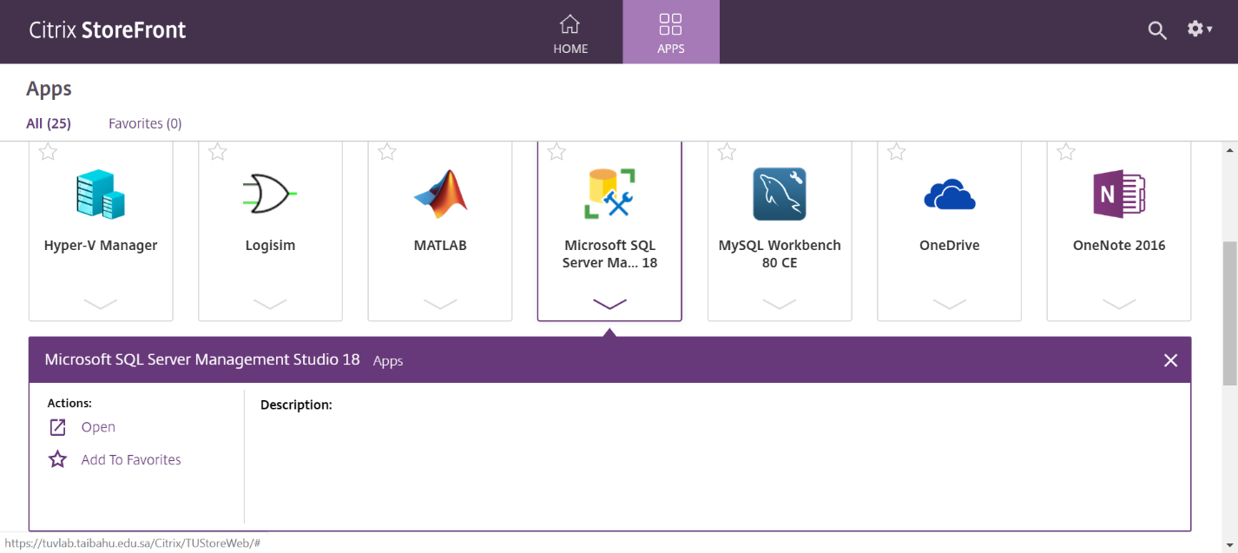
How to use Citrix Applications
12
Click here

Slide 25
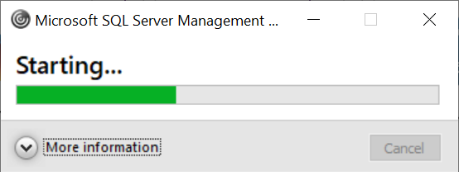
How to use Citrix Applications
13

Slide 26
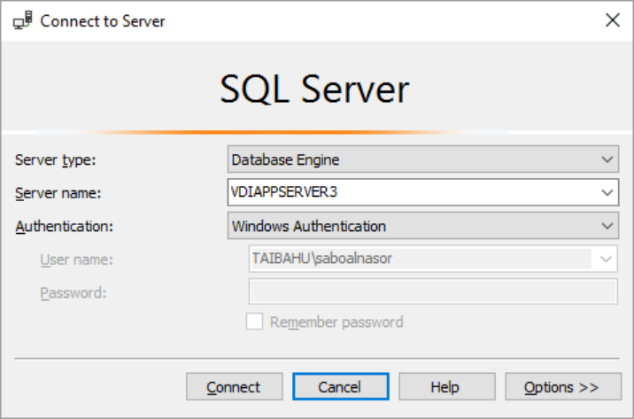
How to use Citrix Applications
13
Microsoft SQL Server Management Studio
Connect

Slide 27


2. SQL statements Categories

Slide 28
SQL statement: SQL statements are divided into three major categories:
1. DDL statements are used to build and modify the structure of your tables and other objects in the database. | CREATE ALTER DROP RENAME
2. Data manipulation language (DML): Responsible for Data Manipulation. | INSERT UPDATE DELETE MERGE
3.Data control language (DCL): used to control access to data stored in a database. | GRANT REVOKE

Slide 29
SQL statement (cont…)
First, we use DDL
TO Create , Alter or drop Structure
Then, we use DML
TO View ,insert ,update or delete data from Structure .
Course
DDL
To control Database and table
Students
DML
To control Data in tables

Slide 30

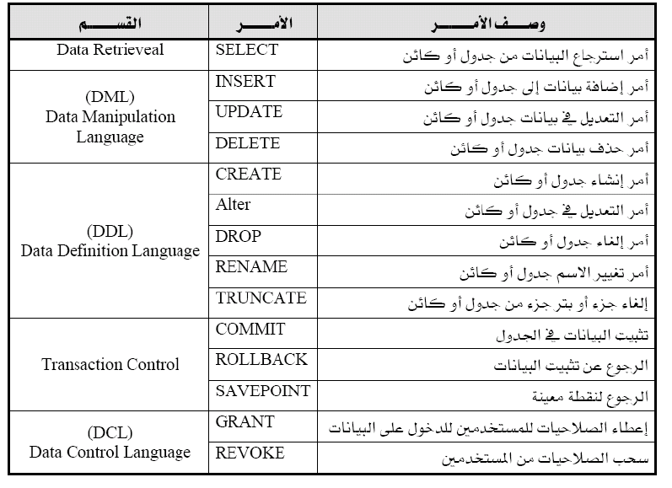
SQL statement (cont…)

Slide 31
Interface of Microsoft SQL Server 2008R2

Slide 32
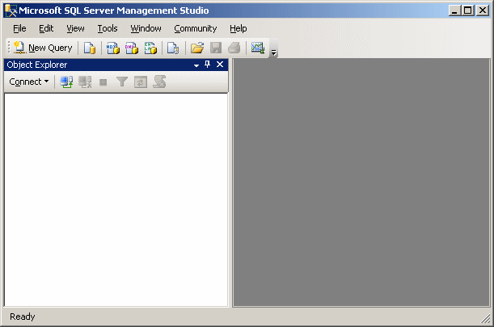
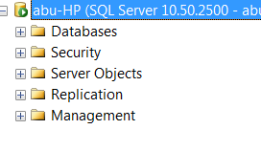
Interface of Microsoft SQL Server 2008R2
Address toolbar
Main Menus
Standard Toolbar
Object Explorer

Slide 33
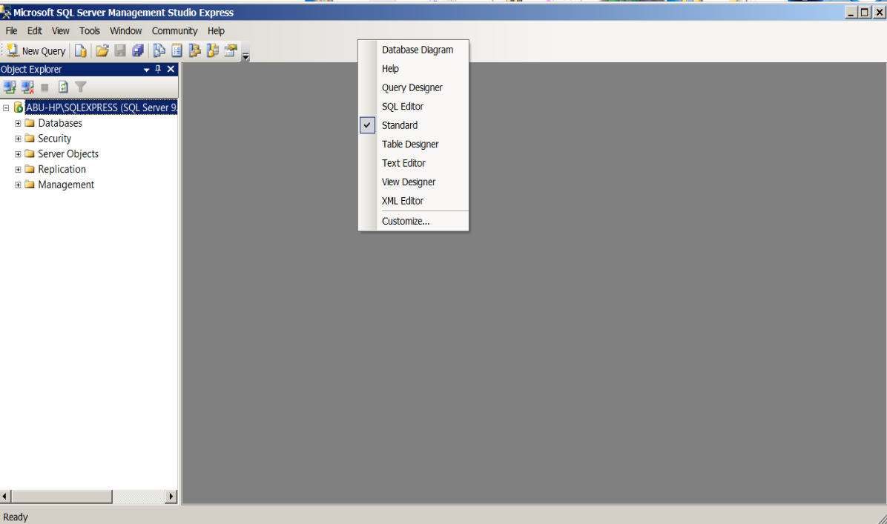
Interface of Microsoft SQL Server 2008R2(cont…)
The Standard Toolbar :
To Display any toolbar, you can right-click on any Menu item on the Main Menus or on any space in Main Menus.

Slide 34
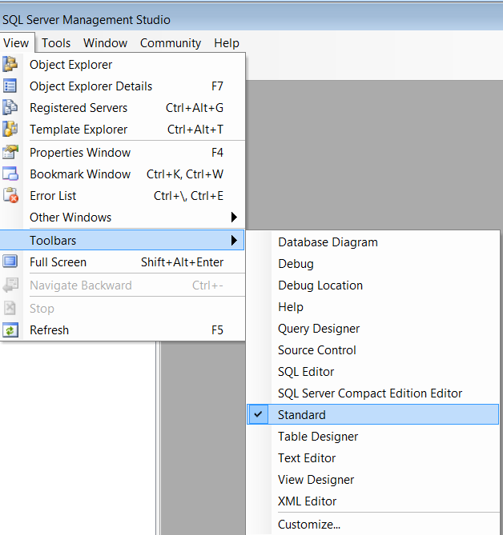
Interface of Microsoft SQL Server 2008R2(cont…)
Also you can Display Standard Toolbar from [View ] Menu as following :

Slide 35
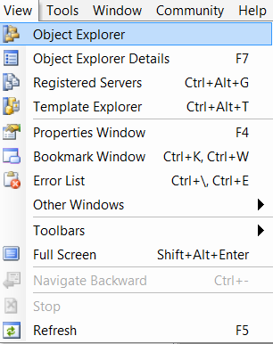
Interface of Microsoft SQL Server 2008R2(cont…)
The Object Explorer :
To display Object Explorer area ,Go to View menu ,as shown below:

Slide 36
Interface of Microsoft SQL Server 2008R2(cont…)
Displays All implementations in a Database

Slide 37
4. Comments AND Naming Rules of tables and Column In SQL Server

Slide 38
COMMENTS
1.Single line:
Syntax: -- Comment
Ex:
-- COMPANY Database
2. Multi lines:
Syntax: /* Comments ... */
EX:
/* COMPANY Database
Employee
2. Department 3. ... */

Slide 39
Naming Rules
Table names and column names:
Must begin with a letter
Must contains only A–Z, a–z, 0–9, _, $, and #
Must not duplicate the name of another object owned by the same user(Within a database, there are not two tables have the same name. Also, there are not two attributes have the same name inside the same table).
Must not be a reserved word

Slide 40

Warning:
SQL statements are not case sensitive. There is no difference between SELECT = select

Slide 41
5.Some of Data definition language (DDL): 1. Create Database 2.Create Table 3.Drop Table 4.Drop Database 6.Alter Table

Slide 42
Our Scope Today is:
1. Data definition language (DDL): Responsible for Data Definition. | CREATE ALTER DROP RENAME
2. Data manipulation language (DML): Responsible for Data Manipulation. | INSERT UPDATE DELETE MERGE
3.Data control language (DCL): used to control access to data stored in a database. | GRANT REVOKE

Slide 43

1. Create Database command in SQL :
Create database:
Ex: create database lab1
CREATE DATABASE database_name

Slide 44
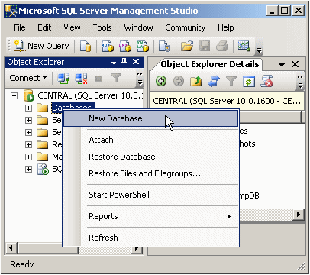
To create Data Base :
By using Object Explorer: Right-click on Databases and choose New Database.

Slide 45
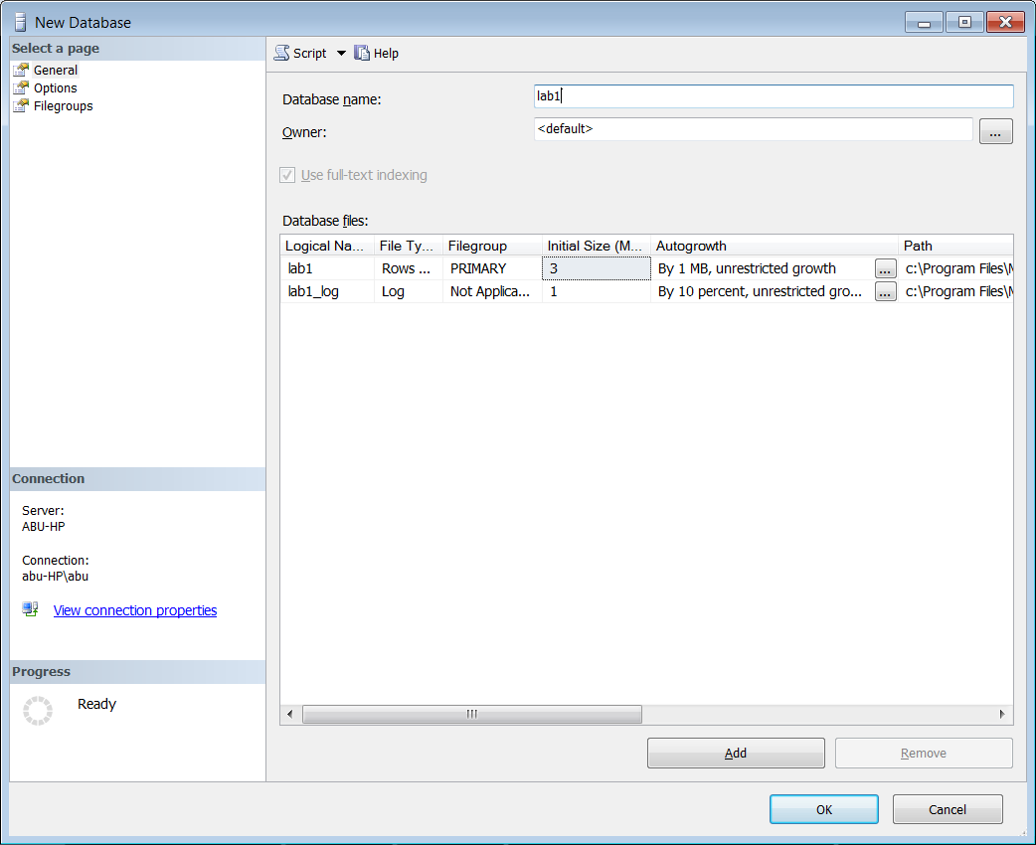
To create Data Base :
By using Object Explorer: Right-click on Databases and choose New Database.
Location of a Data Base

Slide 46
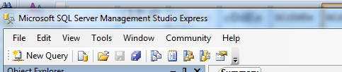

To create Data Base :
By using SQL Statement:
Click on New Query

Slide 47
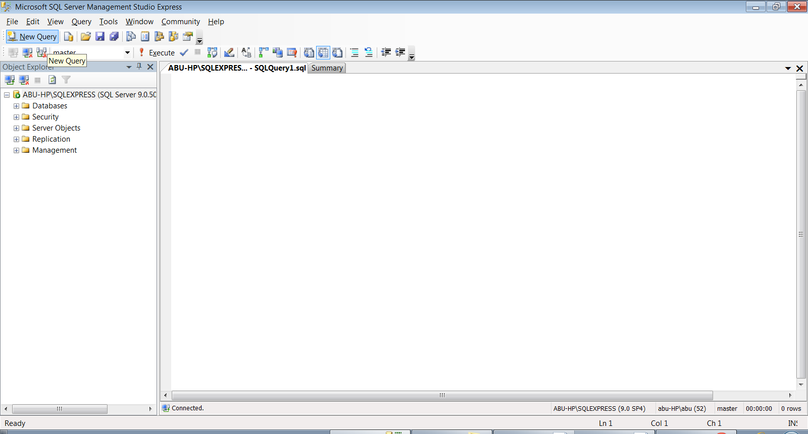
To create Data Base :
By using SQL Statement:
Click on New Query
Here you can write SQL statements

Slide 48
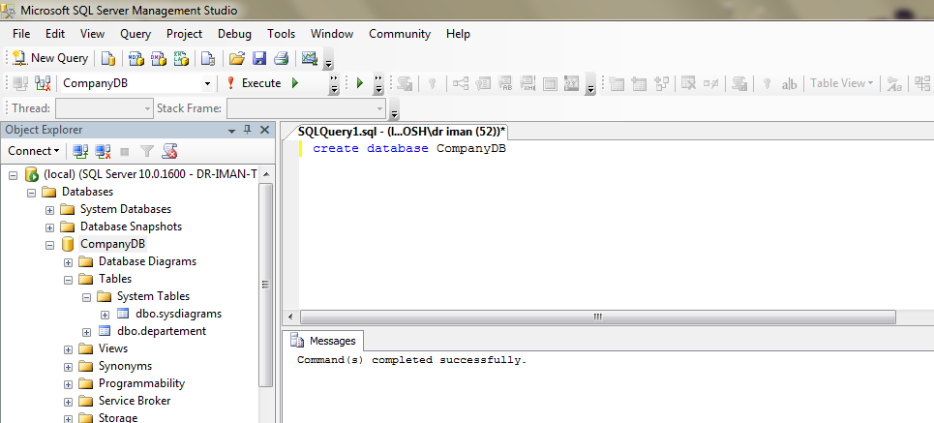
SQL Statements Execution:
The following are different ways to execute any SQL Statements :
Click on Execute icon from SQL editor toolbar, as shown below.
From Query menu, Choose Execute
Press on F5 From Keyboard.
Message: Displays the execution’s result.

Slide 49

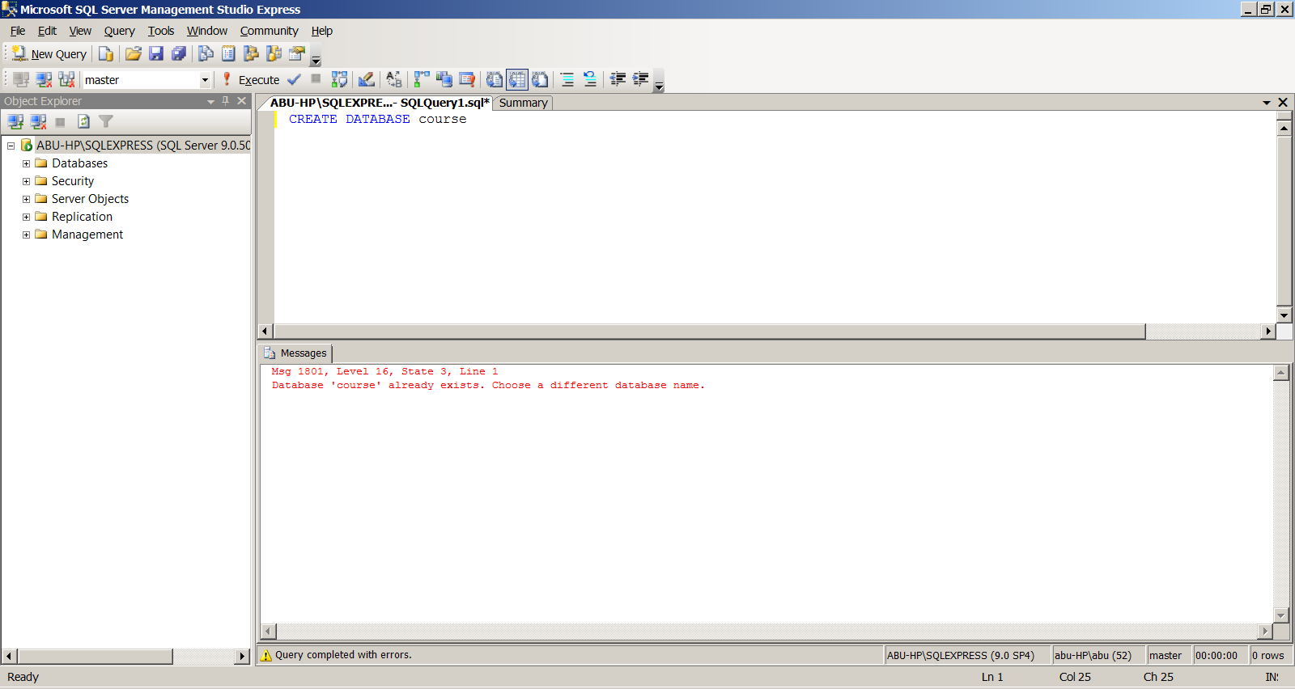
Warning:
Don’t repeat the same instruction more than once.
For example, when you writing the create statement for a database with the same name, it results an error because there is already database with the same name.
Error

Slide 50
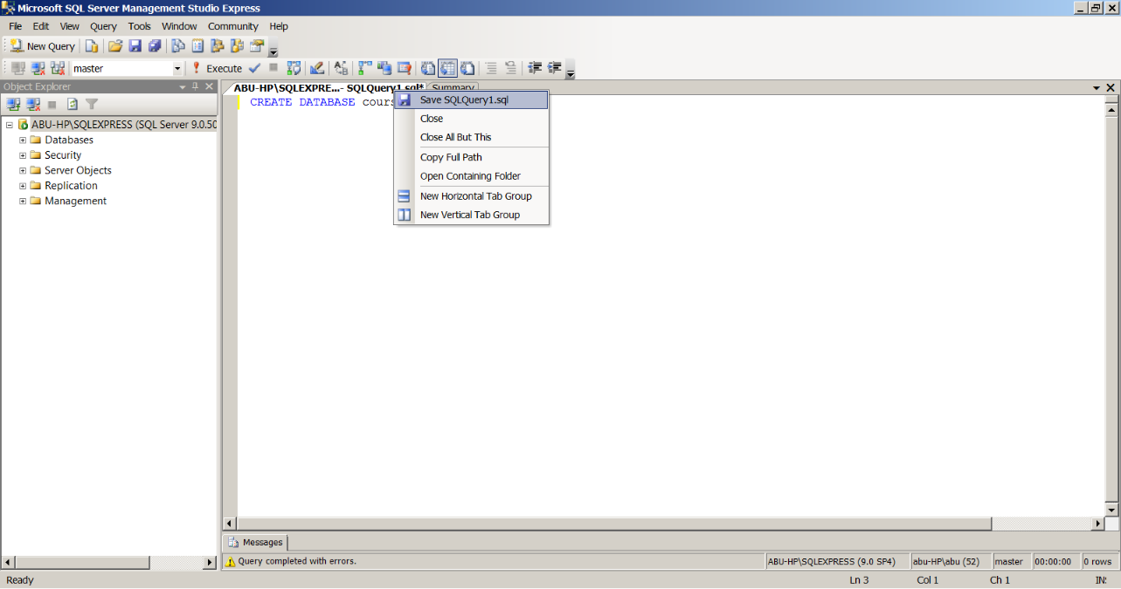
To save SQL Query:
The following are different ways to save SQL Query:
Right click on the created database’s name and choose Save SqlQuery, as shown below.
From [File] menu choose Save SqlQuery
Press on Ctrl+s From the keyboard

Slide 51
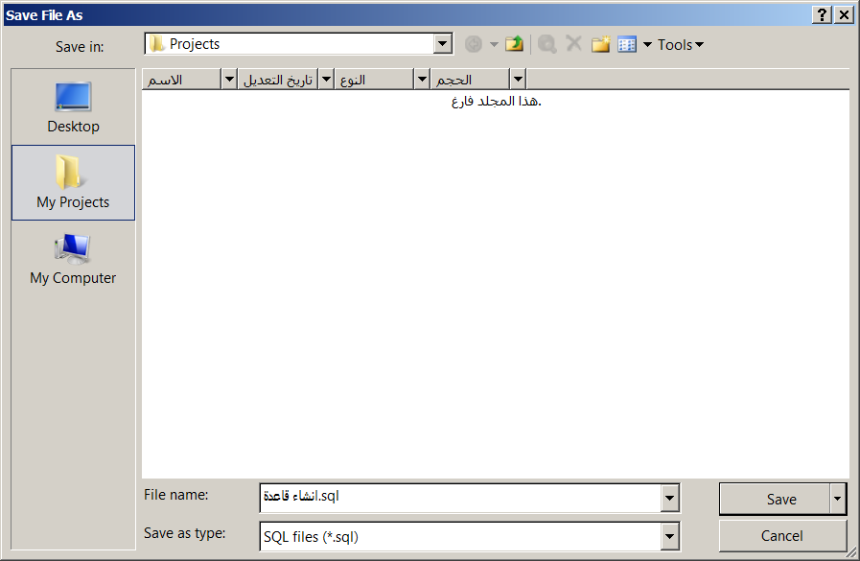
To save SQL Query: (cont…)
Default Directory
File name
File type

Slide 52


2.Create Table command in SQL :
Create Table:
Ex:
CREATE TABLE department
(department_id int,
department_name varchar(255),
date_of_work date)
CREATE TABLE table_name ( column_name1 data_type, column_name2 data_type, column_name3 data_type, ....
)

Slide 53

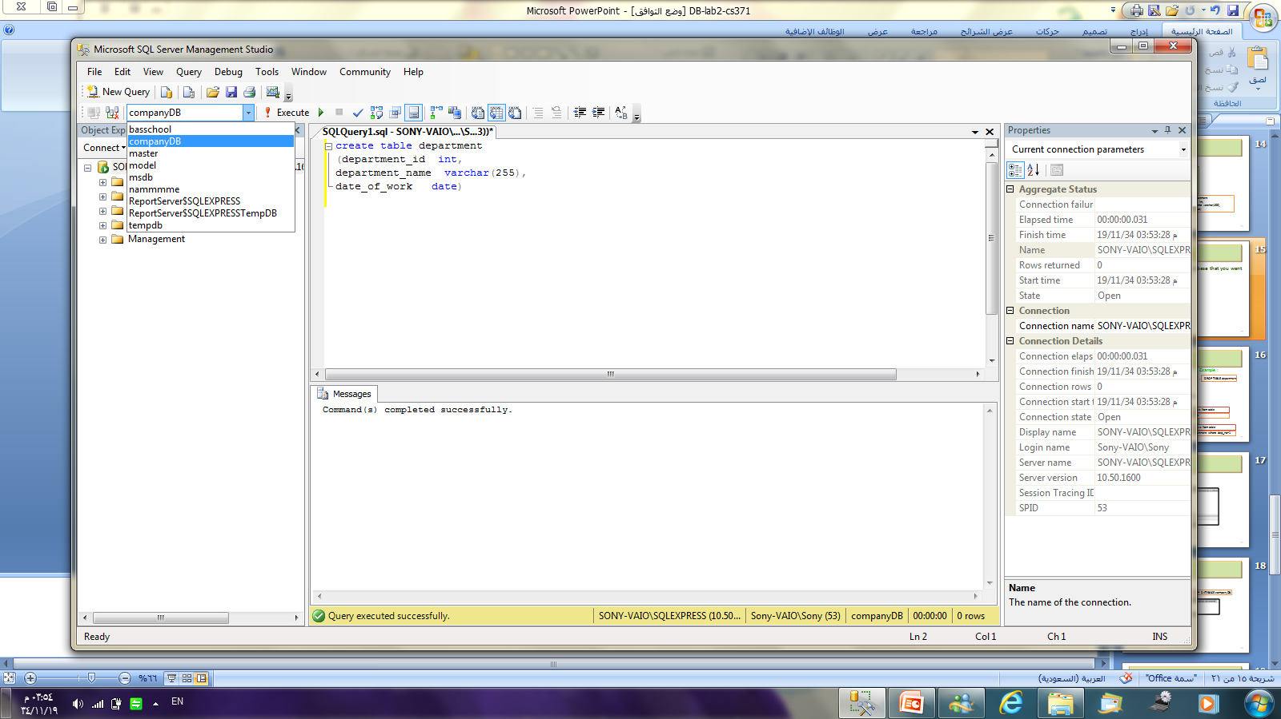
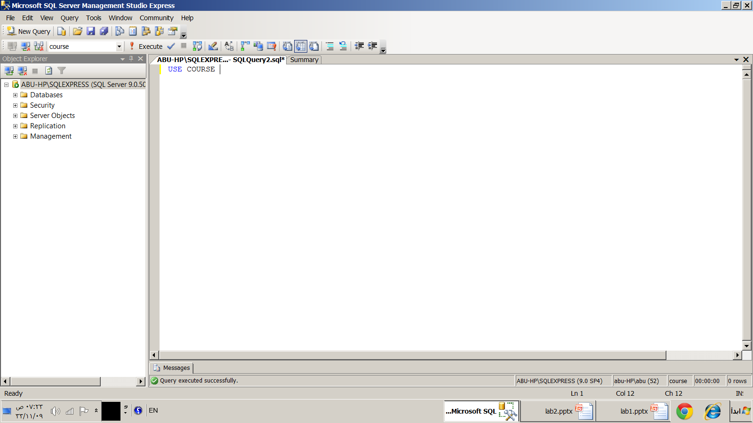
Warning:
Before creating a table, You must specify the required database (the database that you want to create a table inside of it).
There are two ways to specify your database:
Use SQL statement:
USE Database_name
Choose the name of your created database from SQL editor bar

Slide 54

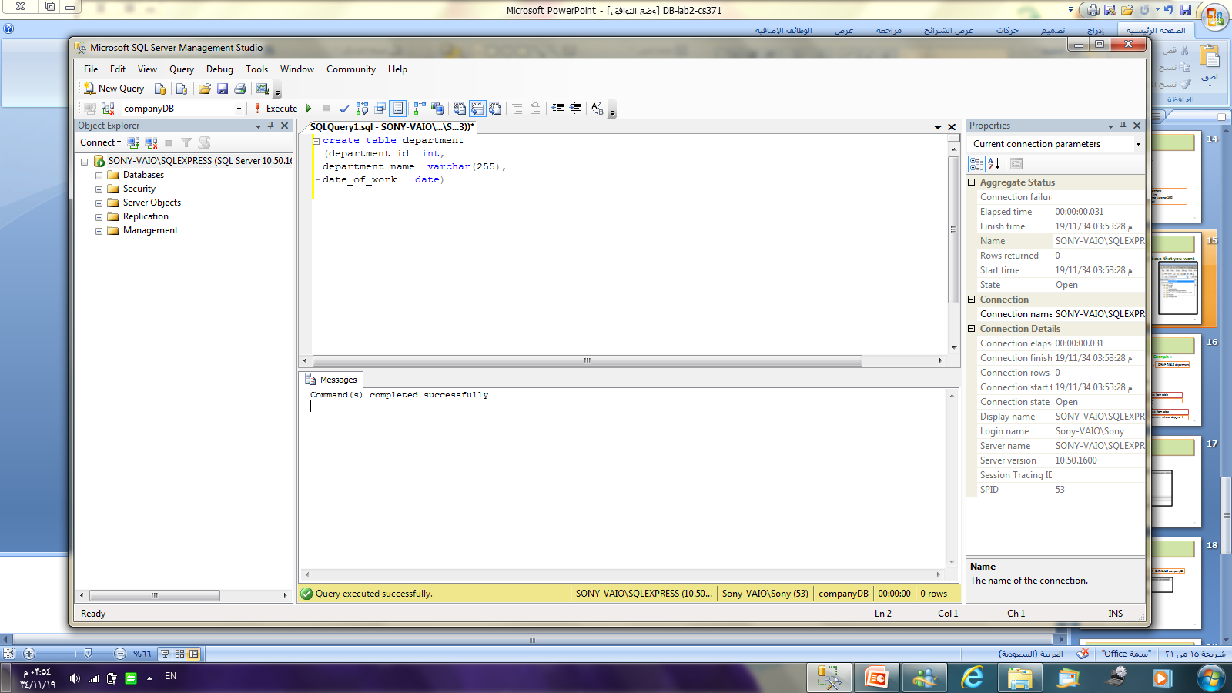
Create a table:
1
2

Slide 55
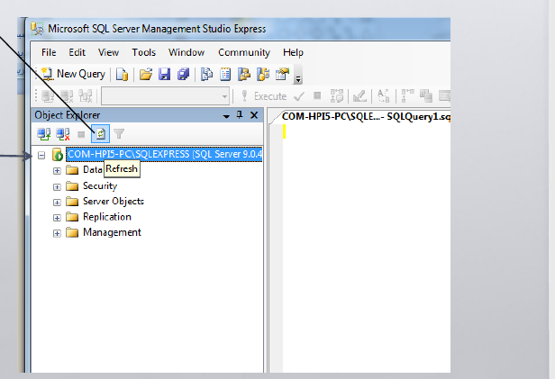
Display the created Database:
2
Click on Refresh Button
1
Select [SQL server]

Slide 56
Display the created Table:
There are two steps to view the Tables:
Step 1: After creating the Table, You have to Refresh the database, as following:
2
Click on Refresh Button
1
Select [SQL server]

Slide 57
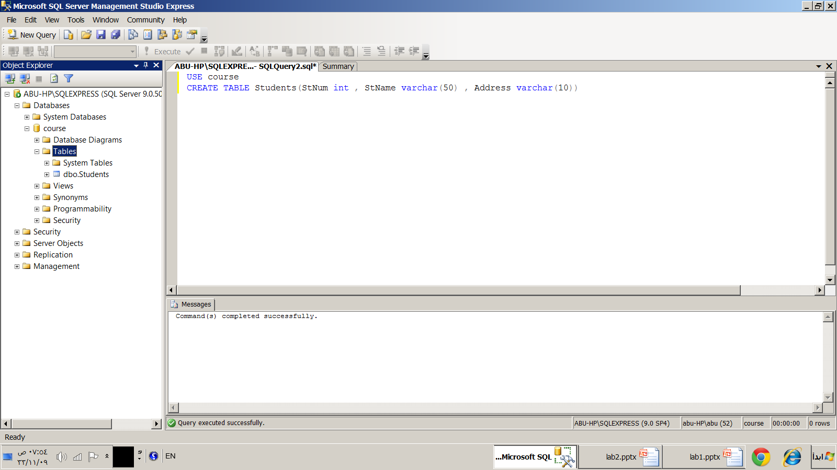
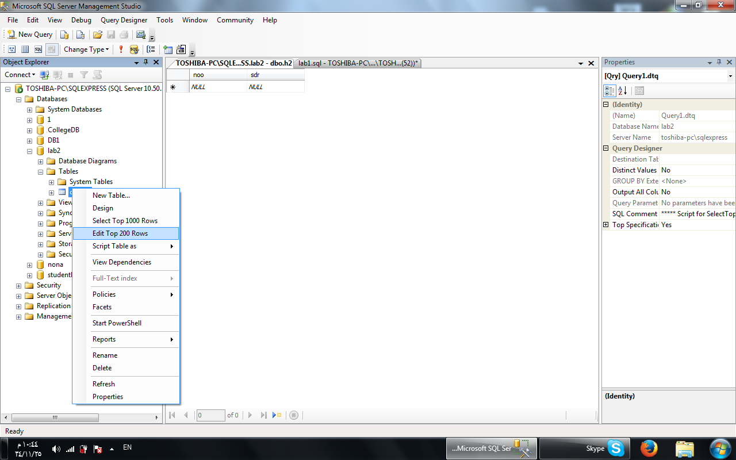
Display the created Table: (cont…)
Step 2: Choose the required Table , as following:
1
3
Choose the required Table by Right click on it and choose [Edit Top 200 Rows]
Choose the required database
2
[Expand [Tables]

Slide 58
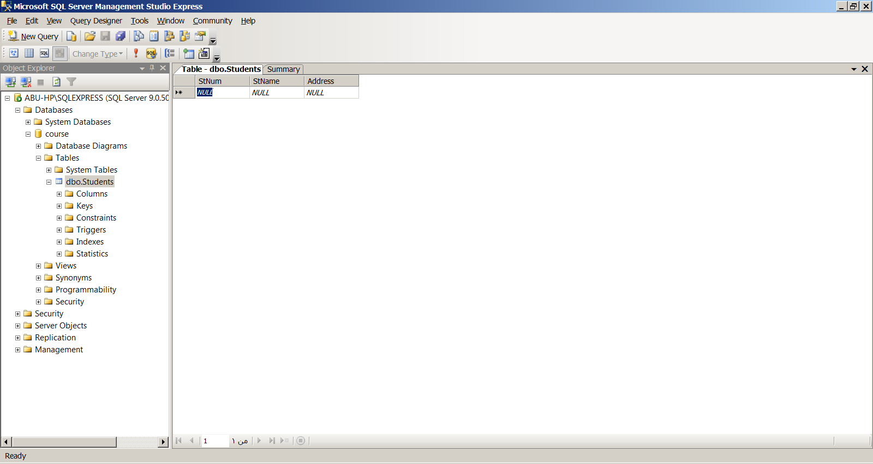
Display the created Table:( cont…)
This is the result of display table process:

Slide 59
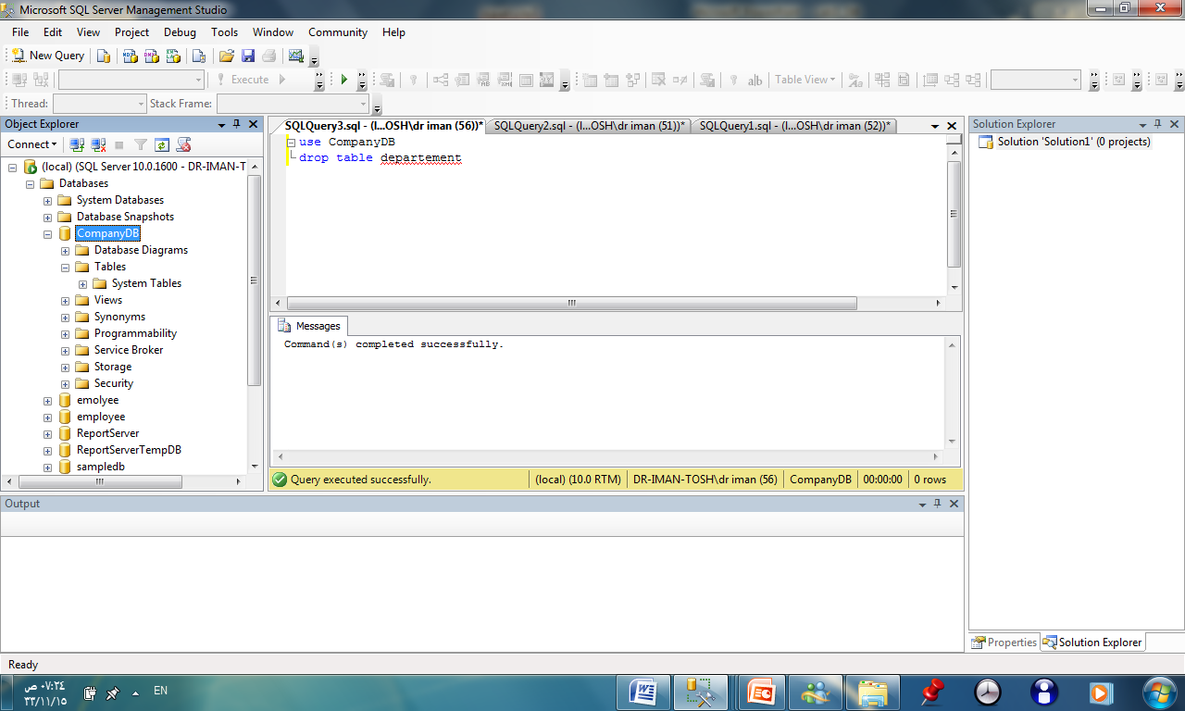
3.Delete Table command in SQL :
DROP TABLE table_name
Drop Table:
EX:
DROP TABLE department
Delete Table:
To Delete all rows content from tables(except the attribute names), write the following statement:
EX:
Delete department
Delete tableName

Slide 60
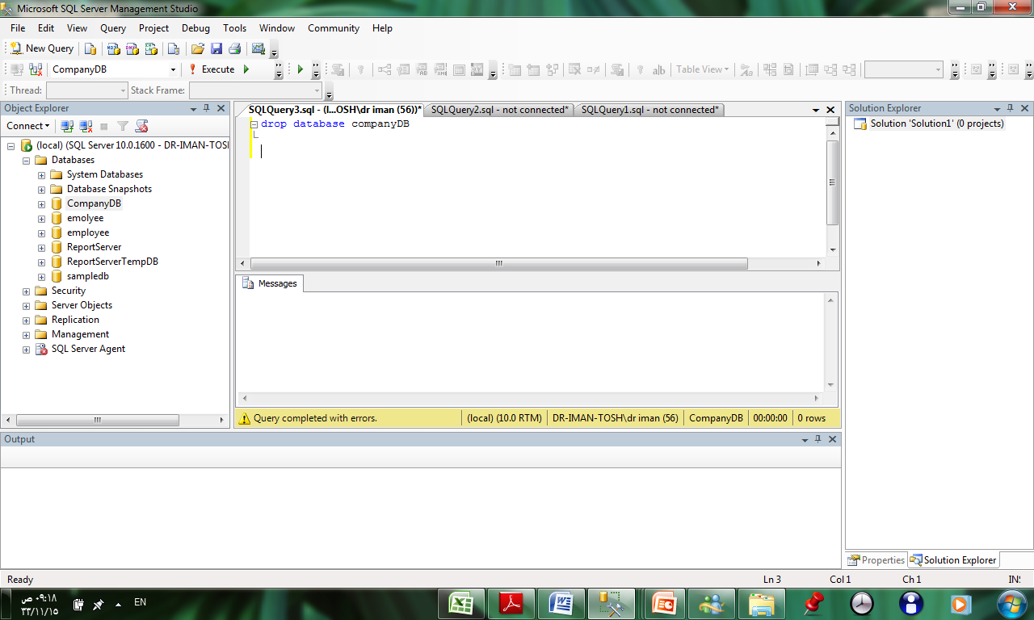
4.Delete Database command in SQL :
Drop Database:
EX:
DROP DATABASE companyDB
DROP DATABASE database_name

Slide 61

Exercise
Create “Course” database.
Create ”courses” Table with the following attributes:
Course_NO
Course_Name
3. Drop “Courses” Table?

Slide 62


After lab:
Switch Off Your Computer
Please Don not Left Things Behind You

Slide 63


Any Questions?..

